Slide 1
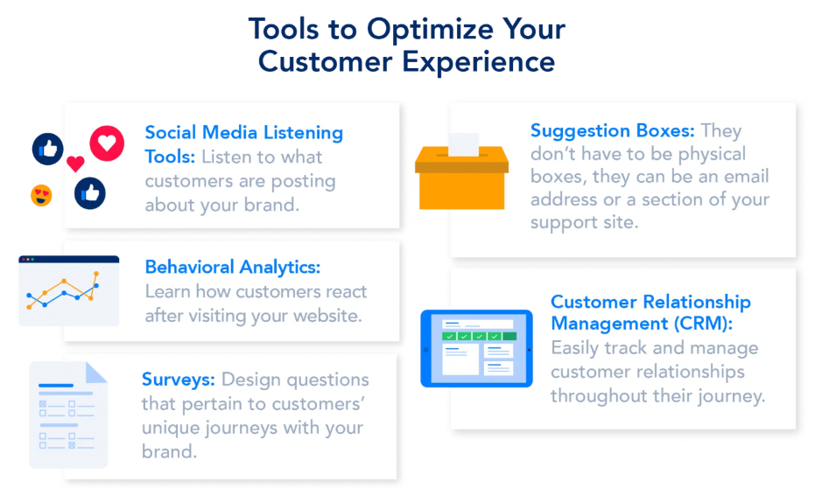
ABC Call Volume Trend Analysis
By Drustant Metar

Slide 2
Project description
The attached dataset is of Inbound calls of an ABC company from the insurance category consists of a Customer Experience (CX) Inbound calling team for 23 days. Data includes Agent_Name, Agent_ID, Queue_Time [duration for which customer have to wait before they get connected to an agent], Time [time at which call was made by customer in a day], Time_Bucket [for easiness we have also provided you with the time bucket], Duration [duration for which a customer and executives are on call, Call_Seconds [for simplicity we have also converted those time into seconds], call status (Abandon, answered, transferred).
Professionals on a customer experience (CX) team examine data and comments from customers, then disseminate their findings to the rest of the company. Customer experience programs (CX programs), digital customer experience, design and processes, internal communications, voice of the customer (VoC), user experiences, customer experience management, journey mapping, nurturing customer interactions, customer success, customer support, handling customer data, and learning about the customer experience are just a few of the roles and responsibilities that these teams typically carry out.

Slide 3
approach
Our collection contains tables with a wealth of information about calls. We thoroughly reviewed the dataset before executing a number of queries to extract relevant data from it.
Find out the null values, blank values empty values and clean it (If applicable).
Use filter, pivot table, and other functions to give answer of asked questions.
To make a proper decision making solution.

Slide 4
Tech-stack used
I used the following tools for complete my analysis
Google drive
Microsoft Excel for analysis
Microsoft Power point

Slide 5
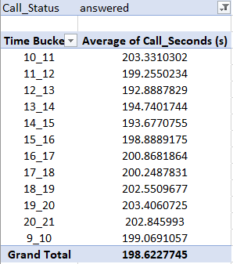
Task 1: Average call duration
Task: What is the average duration of calls for each time bucket?
Determine the average duration of all incoming calls received by agents. This should be calculated for each time bucket.

Slide 6
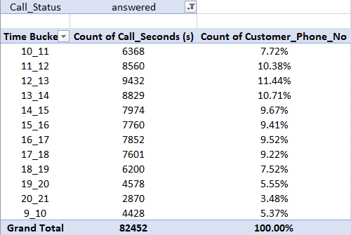
Task 2: Call Volume Analysis
Task: Can you create a chart or graph that shows the number of calls received in each time bucket?
Visualize the total number of calls received. This should be represented as a graph or chart showing the number of calls against time. Time should be represented in buckets (e.g., 1-2, 2-3, etc.).

Slide 7
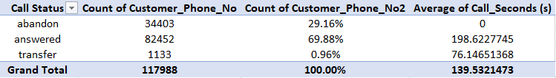
Task 3: Manpower Planning
Task: What is the minimum number of agents required in each time bucket to reduce the abandon rate to 10%?
The current rate of abandoned calls is approximately 30%. Propose a plan for manpower allocation during each time bucket (from 9 am to 9 pm) to reduce the abandon rate to 10%. In other words, you need to calculate the minimum number of agents required in each time bucket to ensure that at least 90 out of 100 calls are answered.
Assumption
Total working hours = 9 hours
Break = 1.5 hours
IT downtime = 0.5 Hours
Meetings = 1 Hour
Actual working hours = 5 Hours

Slide 8
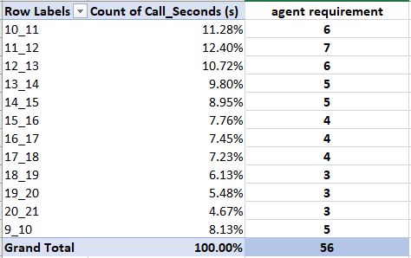
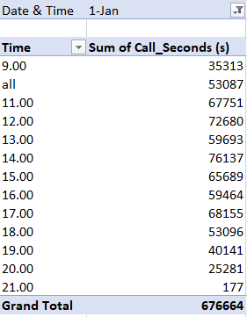

Slide 9
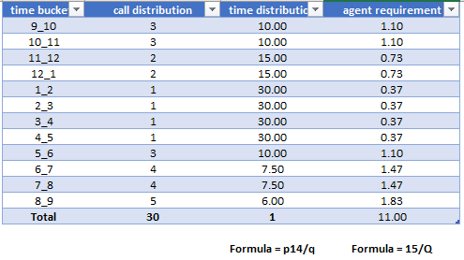
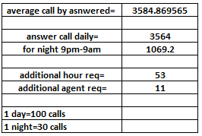
Task 4: Night Shift Manpower Planning
Task: Propose a manpower plan for each time bucket throughout the day, keeping the maximum abandon rate at 10%.
Customers also call ABC Insurance Company at night but don't get an answer because there are no agents available. This creates a poor customer experience. Assume that for every 100 calls that customers make between 9 am and 9 pm, they also make 30 calls at night between 9 pm and 9 am. The distribution of these 30 calls is as follows:

Slide 10
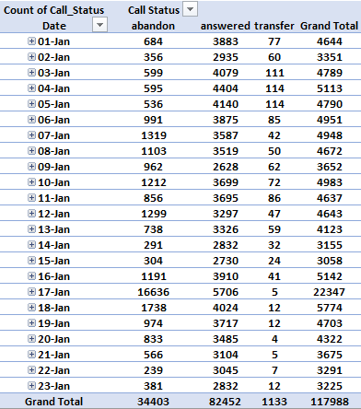
We first calculated the Time Distribution by dividing each calls distribution by total calls i.e., 30.
The number of agents required for each time bucket is calculated by 11 * Time Distribution
11 is calculated above by dividing the additional hours required to answer the night calls by 5
(actual working hours of agents).
Also, while calculating, the round figure is taken into consideration as there cannot be 1.5 men working.

Slide 11
insights
The data revealed that evening hours see the lowest frequency of client calls. This gives the business the chance to maximize its personnel by using fewer agents to handle calls during that period.
The business may want to think about employing fifteen committed customer service representatives who are open at night in order to accommodate the night shift.
Another option is to shift some of the day workers to the night shift, ensuring continuous coverage and efficient call handling throughout the day.
By adjusting the shift timings of the employees, such as having some workers from 5 am to 2 pm and others from 2 pm to 11 pm, the company can maximize the number of calls answered during peak hours.
To ensure round-the-clock availability, the company can divide its workforce into three shifts, enabling agents to be available 24/7 for addressing customer queries and concerns.
It is significant to remember that outliers in the data were found during the analysis. Because these outliers may have influenced the results, eliminating them could potentially result in different answers and outcomes.
These insights give the business practical plans for improving customer service effectiveness, allocating workers more efficiently, and guaranteeing constant availability to meet client demands.

Slide 12
result
I have learned a lot about the significance of an analyst in the customer service division throughout this assignment. It is clear that a business uses efficient customer handling techniques to try to guarantee the highest level of client pleasure.
Among the noteworthy instruments utilized is the Interactive Voice Response (IVR) system, which makes use of artificial intelligence (AI) to respond to consumer inquiries by determining their particular issues and connecting the calls to the relevant representatives for settlement.
The pre-calculated time buckets and call length transformed into seconds simplified the examination of the provided data and saved time and effort in calculations.
I have also ventured into the field of behavioral analytics, which is analyzing patterns of consumer behavior to find trends, preferences, and chances to improve the customer experience as a whole.
All things considered, this assignment has given me insightful information about the workings of customer service and the part analysts play in maximizing client pleasure.

Slide 13
Drive link
Link:
https://docs.google.com/spreadsheets/d/1NPQF-AeqzhtqrB--1XZ7ZhtMyv5Xrtc3/edit?usp=drive_link&ouid=110876986073115360474&rtpof=true&sd=true

Slide 14
Thank you !!!

